Slide 1
LEVEL 1 - DFD
1.1
Android App User
User Request
Receive and Send User Request to Server
2.1
Final Result
Send Signals to GPS Device
Server Reply
Request for Location
3.0
Server DataBase
Reply Back to Server
Inventory Data
4.1
Produce Location Results
D2
GPS Inventory File
D1
Updated Location
GPS Device
Database
Location Reports

Slide 2
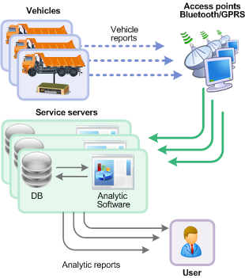
Android App User
Access Points eg GPRS
Server & Database

Slide 3
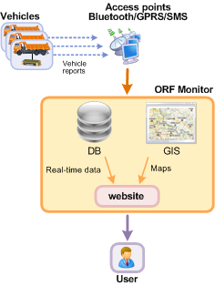

Slide 4
Android Platform
Analytic Software
Requests for location
Android App User
Server & Database
Source & Destination
Unique ID
maps
Sends location Signals
Interprets Signals & Requests for Position Signals
GPS unique ID
GPS Device on Bus

Slide 5
LEVEL 0- DFD
Request for location
Interpretes Requests & Forward it to GPS Device
Android App User
Server & DataBase
Location displayed on map
GLOBAL POSITIONING SYSTEM
Signal Formatting & Analysing from GPS device
Sending Location signals
GPS Device

